Slide 1
An Introduction to
Reinforcement Learning
By Christopher Torrington

Slide 2
Inspired be real life (liken it to things they already now)
- positive reinforcement
- positive reinforcement demo (quick)
Talk about training dogs (go into great detail here)
Teach a dog to sit
- if it sits -> give it a treat | Otherwise no treat
-> the dog learns that sitting gets it a treat
We are going to conceptualises these into a more structured way
Introduce states, actions & rewards

Slide 3
Not doing GPI – doing eval & iteration separately. No Dynamic programming

Slide 4
To keep abstracting -> introduce Agent & Environment words
Give examples (dog is agent, environment is everything else)
Agents interact with the environment.
The agent can be in different states (sitting, standing walking)
The agent can take different actions (sit, jump, paw) – in certain states
How do all these things (States, Actions & Rewards) link together?

Slide 5
Markov Decision Process

Slide 6
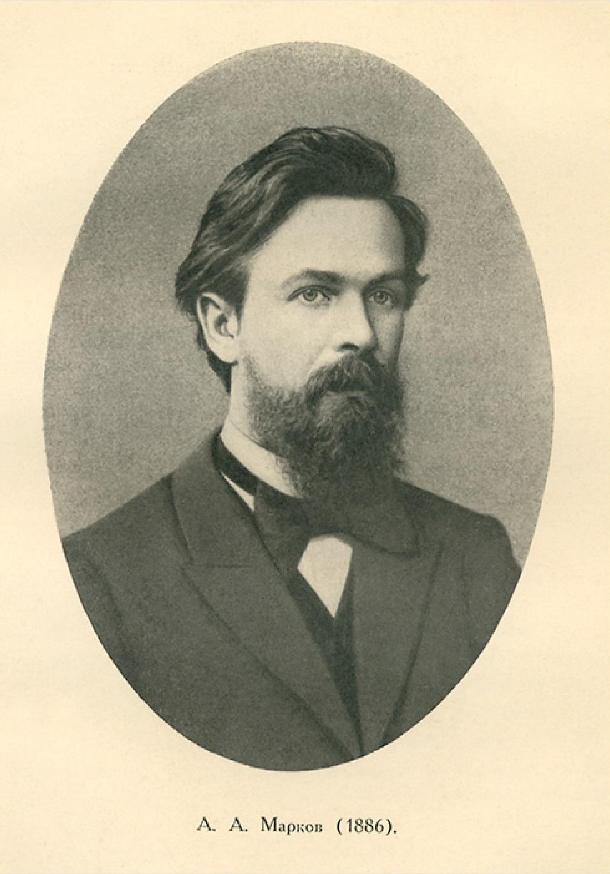
Andrey Markov
Notes:
The name of MDPs comes from the Russian mathematician Andrey Markov as they are an extension of Markov chains.

Slide 7
Main
Space
reward
+
0.5
Academy Room
1
No reward
0
Outside
- reward

Slide 8
Emphasise these things (maybe don’t need to say these things?) Tabular solution method
FINITE MDP (set of S,A,R have FINITE number of elements)

Slide 9
We can do whatever we want with states (abstract idea)
In code example – use Grid World (incredibly common example)
In grid world -> show different how abstract the idea is.
ie. Can move up, down, left, right (maybe diagonal, maybe edges)
Talk about being in a state, choosing an action -> moving to another
state, getting a reward…. Being in a state, choosing an action…

Slide 10
Grid World

Slide 11
Agent-Environment Interactions
$$p\left(s^{′}, r \right| s, a) \text{≐} \text{Pr}\text{\{}S_{t}=s, R_{t}=r | S_{t −1}=s, A_{t −1}=a\}$$
S₀
A₀
R₁
S₁
A₁
R₂
S₂
A₂
R₃
S₃
A₃
R₄
…

Slide 12
Goals & Rewards

Slide 13
EXPLAIN
Rewards are NOT the same as returns.
The return of a state is the expected return (the value of the state).
Rewards say what you want (sit for a treat)
Returns are the Value of a state (if told to lie down (reward), sitting will
have a higher value (return) than standing (next state gets reward)

Slide 14

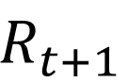
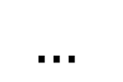
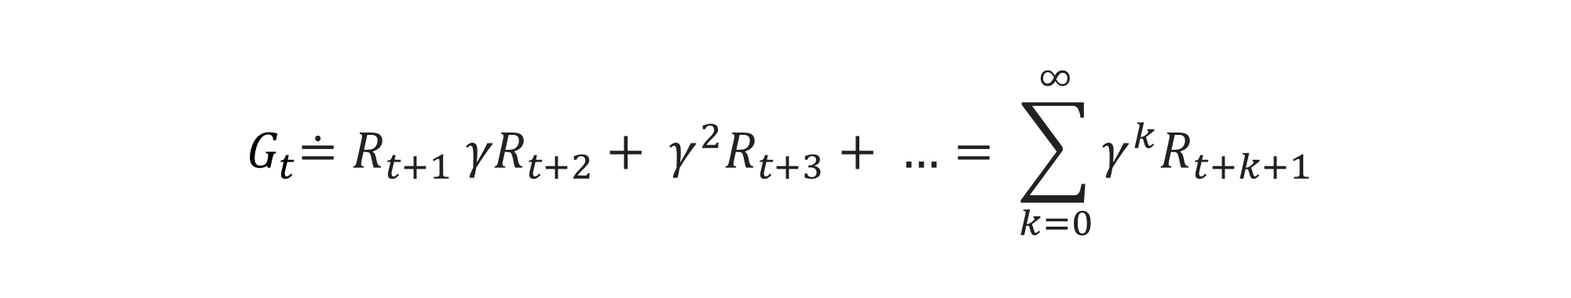
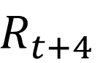
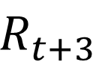
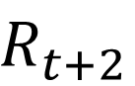
Rewards
$$G_{t}\text{≐} R_{t+1} {γR}_{t+2}+ γ^{2}R_{t+3}+ …= \sum_{k=0}^{∞}{γ^{k}R_{t+k+1}}$$
$$R_{t+1}$$
$$R_{t+2}$$
$$R_{t+3}$$
$$R_{t+4}$$
$$…$$
$$G_{t}\text{≐} R_{t+1}+ R_{t+2} R_{t+3}+ …+ R_{T}$$

Slide 15
Returns & Episodes

Slide 16
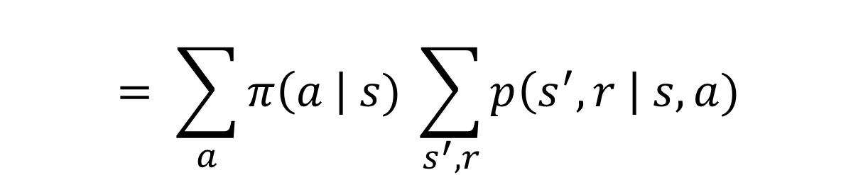
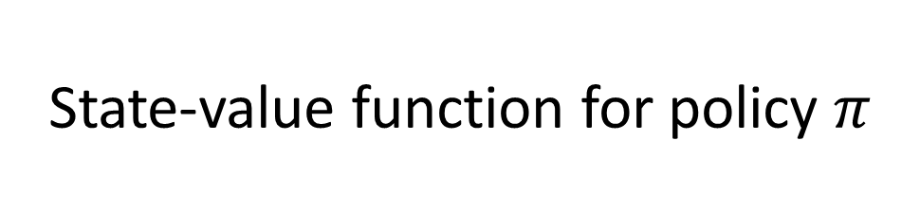
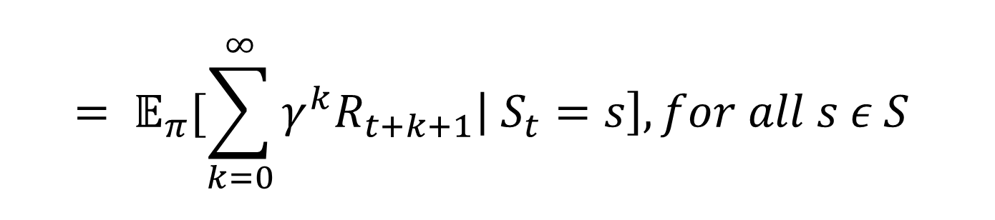
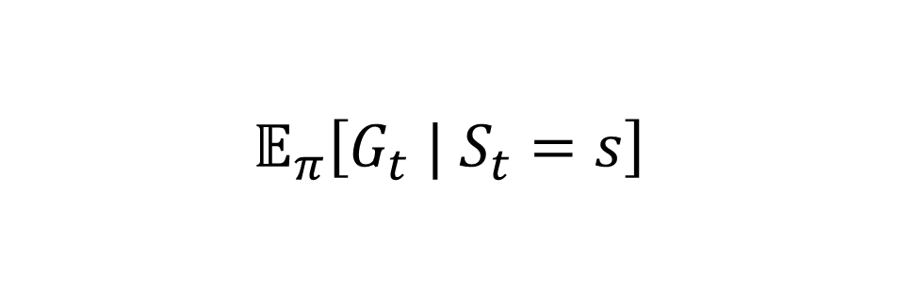
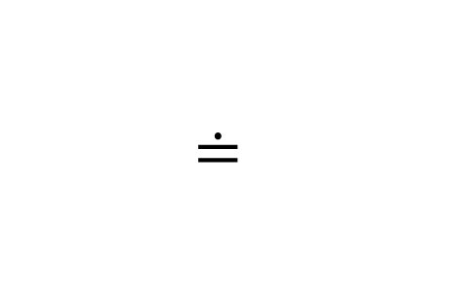
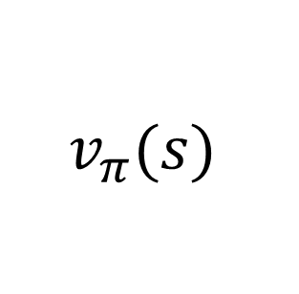
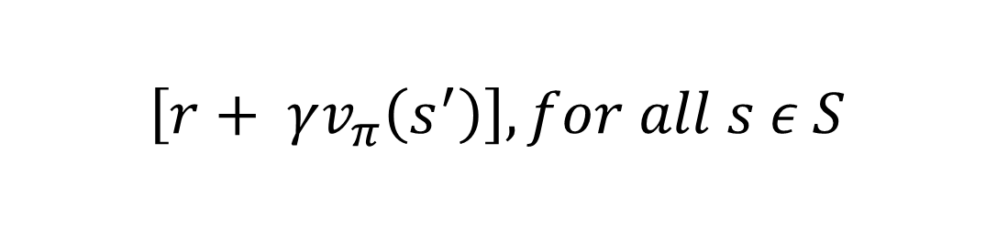
State-value function for policy $π$
$$v_{π}(s)$$
$$≐$$
$$𝔼_{π}\left[G_{t} | S_{t}=s\right]$$
$$= 𝔼_{π}[\sum_{k=0}^{∞}{γ^{k}R_{t+k+1}\left| S_{t}=s\right], for all s ε S}$$
$$= \sum_{a}{π\left(a \right| s) \sum_{s^{′}, r}{p\left(s^{′},r \right| s, a)}}$$
$$\left[r+ γv_{π}\left(s^{′}\right)\right], for all s ε S$$

Slide 17
Include the backup diagram here

